Slide 1

115.113 Economics for Business
Lecture 1

Slide 2
Administration
Assessment
6 Quizzes (20%). We take the best 5 grades.
Mid-Semester Test (40%)
Final Exam (40%)
TEXTBOOK
The CORE Team (2017)
The Economy (Version 1.0)
Downloadable at https://www.core-econ.org/project/core-the-economy/
Staff at Auckland
Professor Faruk Balli

Slide 3
What is Economics?
There are many definitions of economics:
•How society allocates its scarce resources to satisfy its (unlimited) wants (and/or needs)
Key concept: Scarcity !!!!
  Q: Is there any market for Air?
  Not in Earth so far!!
•The study of mankind in the ordinary business of life
•A mechanism for interpreting human behaviour

Slide 4
Key fundamental principles of economics
Key fundamental principles of economics:
Scarcity
When a resource is limited or restricted in supply, and
there’s not enough of it to meet demand
Scarcity requires decisions to be made
What is the best use of the resource in question?
Wants (goals)
What are wants/goals for a business?
What are wants/goals for an economy?

Slide 5
Key fundamental principles of economics:
Opportunity cost
The value of the next best alternative foregone
What you give up to get something!
What is the opportunity cost of taking Economics Degree?
It is subjective/depends on your ability's skills
  Is it feasible for Leo Messi to study economics for 3 years in Span?
The benefit-cost principle:
  Something is worth doing if the marginal benefit of
  doing it exceeds (or at least equals) the marginal cost of
  doing it
  Marginal = additional, or incremental

Slide 6
Microeconomics Vs Macroeconomics
Microeconomics examines the economic behavior of individual units such as businesses, households in the face of scarcity, government interactions as well as economic consequences of these actions on other actors
Macroeconomics examines the economy as a whole with a view to understand interaction between economic aggregates such as national income, employment and inflation.

Slide 7
Key Macroeconomic Indicators
GDP
Inflation
Unemployment
Trade Balance
Exchange Rate

Slide 8
Latest Update
THE NEW ZEALAND ECONOMY
What’s happening in the New Zealand economy?(Treasury, July , 2026)
•Slowing economic momentum(2025)
•Post-tariffs –slowing global activity(2025)
•Uncertainty around trade policy(2025)
Inflationary Pressure
Economic growth is limited
RBNZ increases interest rate (expecting to increase more)

Slide 9
Unit 9
1
The labour market: Wages, profits, and unemployment

Slide 10
9.2. Measuring unemployment

Slide 11
The Unemployed
The unemployed are the people who:
Not in paid employment or self-employment
Available for work
Actively seeking work
There are three important criteria used to define who is unemployed.

Slide 12
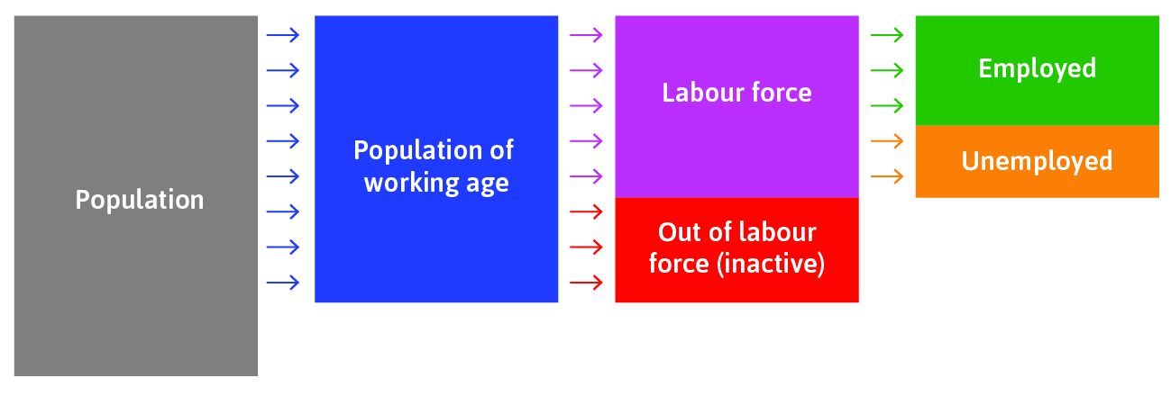
The labour market

Slide 13
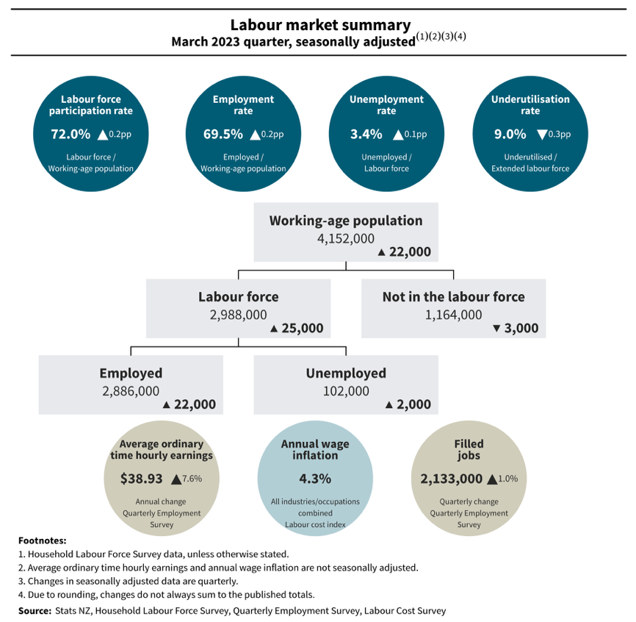

Slide 14



Labour market statistics
Two countries with the same unemployment rate can differ in their employment rates if one has a high participation rate and the other has a low one.

Slide 15
LABOUR MARKET CALCULATIONS: ANEXAMPLE
If an economy has a population of 4 million people and a labour force of 3 million people, of which 100,000 of these are unemployed, what is the unemployment rate?
^{(a) 2.5%}
^{(b) 3.33%}
^{(c) 1.33%}
^{(d) 36.67%}

Slide 16
Labour market statistics differ widely across countries

Slide 17
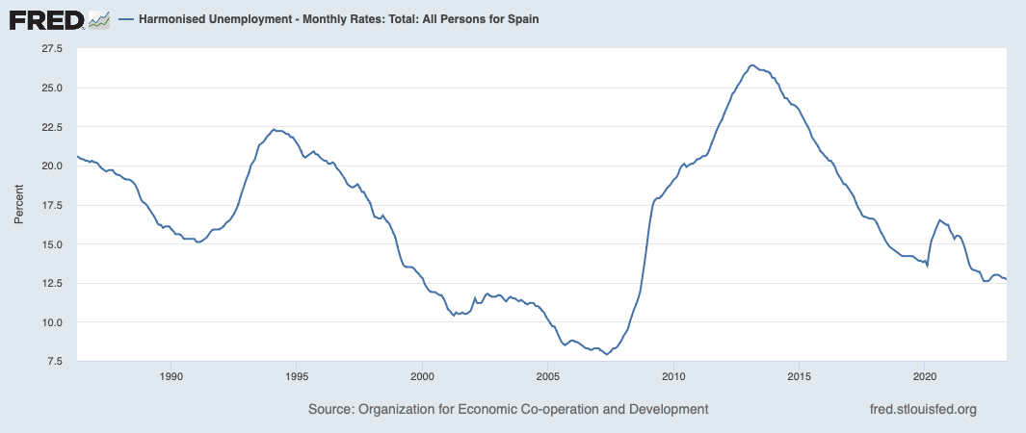
Spain Unemployment Rate
Spain’s unemployment rate in 2023 is higher than NZ.
Its labour market participation rate (58.5%) is lower than NZ.

Slide 18
Unemployment
3
Types of Unemployment

Slide 19
4 types
Short Run: Cyclical
  Relates to the business cycle.
  Recessions cause unemployment to rise
  Caused by sticky downward wages.
Long Run: Frictional and Structural
  Frictional unemployment consists of people between jobs
  Structural unemployment results from a mismatch in skills.
Seasonal
  Many agricultural jobs are seasonal in nature
From Shapiro 8.3 and 8.4
  Cyclical
  Frictional
  Structural
From Akoranga Book
  Seasonal

